Slide 1


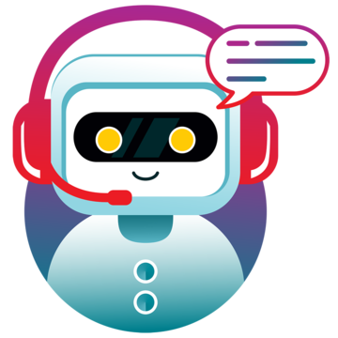
CSA1360-THEORY OF COMPUTATION FOR COMPUTATIONAL LOGIC
MINI PROJECT-MAR 2024
BUILT A CONVERSATIONAL CHATBOT USING PYTHON
GUIDE BY:
DR. LATHA
PRESENTED BY:
K.MAHENDRA REDDY(192210413)
U.MAHESWARREDDY(192210540)
T.CHARAN KUMAR REDDY(192210587)

Slide 2

ABSTRACT:
The goal of this project is to use the Python programming language to create a chatbot. Because they can mimic human discussions and offer automated assistance, chatbots have become increasingly popular in a variety of fields, such as customer service, e-commerce, and personal assistance. Python is a great option for creating chatbots because it offers a robust ecosystem of NLP and machine learning libraries and frameworks.
Overall, this project will highlight the potential of chatbots to improve user experiences and expedite interactions in a variety of sectors, as well as the strength of Python for creating intelligent conversational agents.

Slide 3
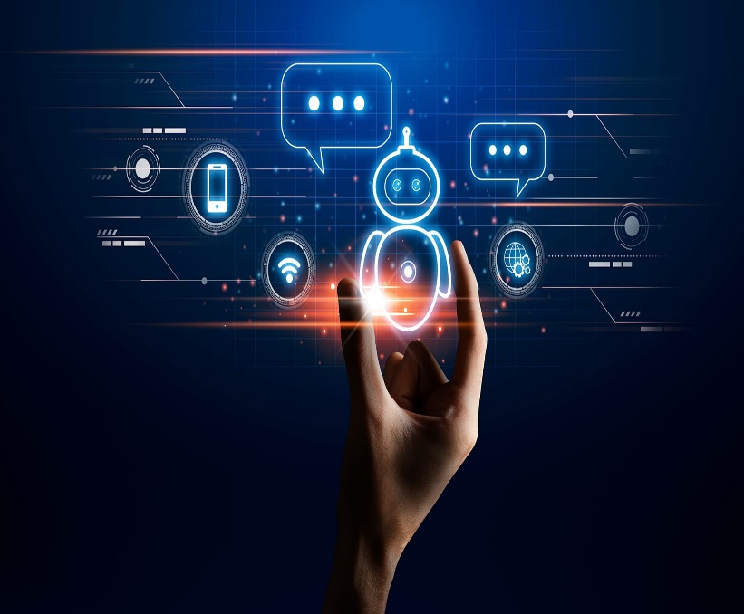
INTRODUCTION:
In recent years, conversational chatbots have emerged as powerful tools for automating customer service, providing assistance, and enhancing user experiences across various platforms.
Recognizing the Fundamentals
Selecting a Method for Development
Choosing a Library or Framework
Gathering or Producing Data
Data Preprocessing
Educating the chatbot
Constructing the Chatbot's Interface
Examining and Re-evaluating
Making the Chatbot Work
Inspection and upkeep

Slide 4
OBJECTIVES:
Gain proficiency in NLP techniques to enable the chatbot to understand and process human language effectively.
Develop the ability to recognize user intents and extract relevant entities from user queries.
Implement dialogue management strategies to facilitate coherent and contextually relevant conversations.
Generate meaningful and personalized responses to user queries based on context and intent.
Integrate the chatbot with popular messaging platforms to reach a wider audience and facilitate seamless interactions.
Deploy the chatbot on cloud platforms for scalability, reliability, and accessibility.

Slide 5

METHODOLOGY:
Understand the purpose and goals of the chatbot.
Design the conversational flow, including user prompts, responses, and error handling.
Decide on a messaging platform for deployment, such as Slack, Facebook Messenger, or Telegram.
Gather or create datasets for training NLP models, if applicable.
Experiment with different algorithms and parameters to optimize model performance.
Develop the chatbot application using Python and chosen libraries/frameworks.
Perform integration tests to verify the overall system behavior.

Slide 6

ADVANTAGES :
▶
Rich Ecosystem
Flexibility and Versatility
Community Support
Machine Learning Capabilities
Integration with External APIs and Services
Scalability and Performance
Cost-Effectiveness

Slide 7
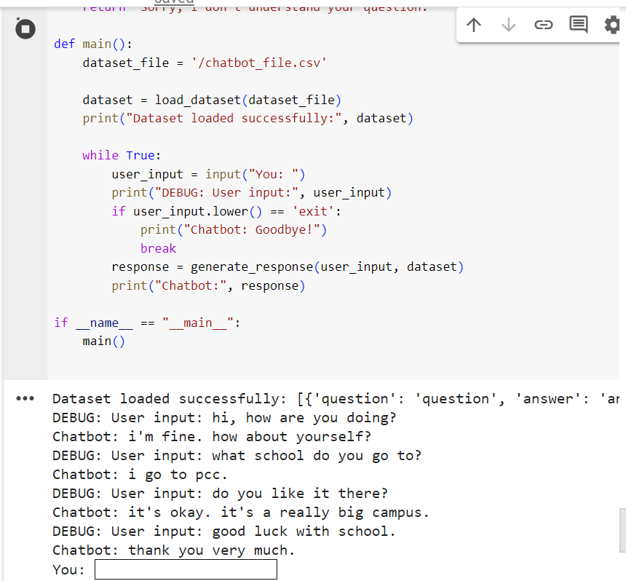
OUTPUT SCREEN:

Slide 8

CONCLUSION:
In summary, creating a chatbot with Python presents a viable way to improve user engagement and automate a range of operations in a variety of industries. With this research, we have shown how natural language processing (NLP) and machine learning techniques may be used to build an intelligent conversational agent that can comprehend user inquiries and provide real-time responses

Slide 9

FUTURE SCOPE
Future chatbots will likely employ more sophisticated NLU techniques, enabling them to grasp the nuances of human language better. This could involve leveraging deep learning models trained on vast corpora of text data to understand context, sarcasm, ambiguity, and emotion in user inputs

Slide 10


